Slide 1
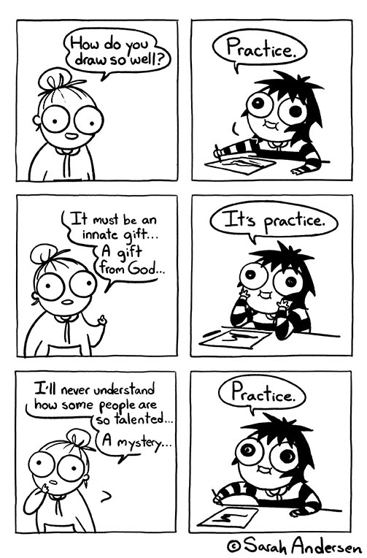
User Interface Design

Slide 2
UI Design: Friday Week 2
Dr. Jillian Aurisano
Plan for today:
Announcements/Course logistics
Sketching review
Sketching an interface
Sketching activity
Notes:
So welcome to engineering visual interfaces for data science. I'm Dr Aurisano.
Thanks for finding the class on Zoom. Hopefully we will be in person again soon.
If anyone out there is comfortable turning on their cameras, that is lovely- then I feel like I am talking to students, rather than to myself.
Here’s our plan for today:
First I’m going to introduce myself, so you know a bit about me
Then we are going to get to know each other, in Zoom breakout rooms. This will give us a chance to make sure that Zoom breakout rooms work, and we all know how to access them.
Then, I am going to walk through the structure, and plan for the course. I want to make sure everyone knows how the course will work, and what to expect, and also a bit about why the course is designed this way.
Then I am going to introduce the class, and what the class is about. Since this is a new class, and one of just a few classes in human centered computing here at UC, I wanted to give an overview of the topic.
Then I have an introductory activity, which we will do in breakout rooms, and which I think will help motivate the discussion on Wednesday, and getting into the meat of the class.

Slide 3
Announcements / Course logistics
Sketching activities today and Friday
Always save your sketches
Homework 2- Questions?
Change- see announcement
Ask Discord if you encounter coding issues, installation problems, VS code questions. This is always faster than asking me!
Project 1- Questions?
Note – Week 3 the homework will be a project 1 check-in, due Monday Sept 16

Slide 4
Project
Examples from last year
Upcoming deadlines
Pick your smart object due today
Project 1 design check in- next Wednesday Sept 20
Submitting in-class sketches
Questions

Slide 5
Needs, design challenges, sketching alternatives What’s next?
Need: People want to be able to exchange photos easily with someone who is nearby
Design Challenge: They don’t want to go through a complex authentication protocol to connect to the other phone
Sketching alternatives:
Maybe they write the same keyword
Maybe they do a phone handshake
Maybe they use the flashlight somehow
Maybe they draw a picture together
Maybe they put their phones together and play a game
Maybe they play a song and the other phone recognizes the song
….
Design funnel : Pick one and elaborate/explore
Ok, phone handshake
phones tap a. in the front, b. in the back, c. at the sides?
Phone shake up and down without tapping?
….

Slide 6
Why sketching and not words?
Sometimes we start with a label for the concept but….
Sketching gets us closer to realizing this concept with a visual design
Sketching helps us identify problems with our concept
Fast, easy way to begin to test your concept

Slide 7
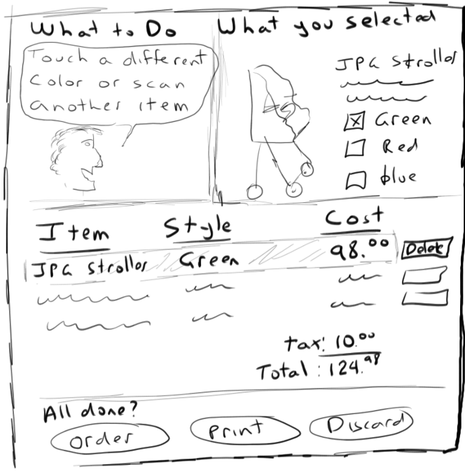
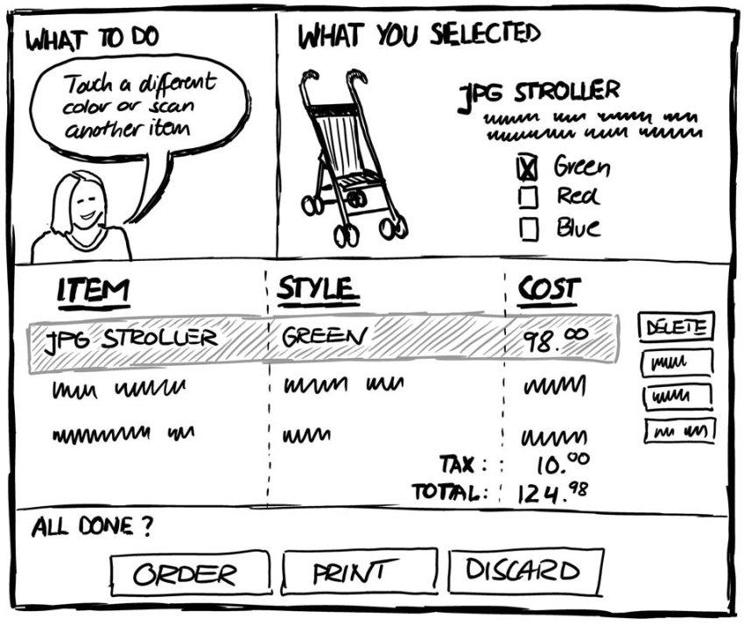
What’s next?
Sketching an interface prototype
First one- can be VERY sketchy
Get iteratively more concrete
Critique your design and feedback as you go

Slide 8
Ways to “sketch” interface prototypes
The Vanilla sketch (focus for today)
The Digital Sketch
The Sticky-note sketch
Sketching with a template
Photo traces
Hybrid sketches
Physical mock-ups
All of the above- starting with sketching the interface at one moment in time
We will do storyboarding later…

Slide 9
The Vanilla sketch
What most people think of as a sketch
Want to prototype the presentation of content, layout, UI elements
Example:
Shopping app
What is included in this sketch?

Slide 10
The Vanilla sketch- from low to high fidelity
Where you start
Where you end up after you are satisfied

Slide 11
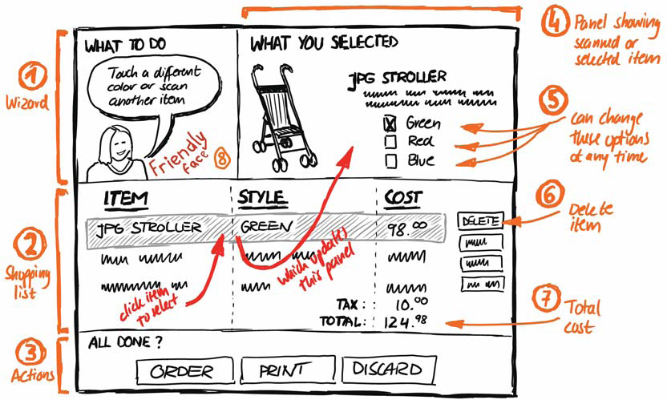
Tools for a Vanilla sketch: Annotations
You don’t just have to show the interface
What is in this sketch?

Slide 12
Annotation tips:
Labels
Explanatory notes
Location of annotation correlates with region of the UI we are commenting on
Example
proximity to area
braces for large areas
arrow to specific area

Slide 13
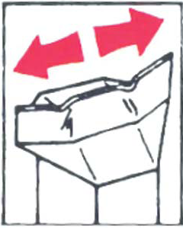
Arrows as Annotation
Can also
emphasise area of interest
relate different parts of a sketch
indicate direction
show movement
indicate a sequence of events (interaction flow)

Slide 14
Arrows as Annotation
Although we are sketching a moment in time, we can convey causality, or the relationship between parts of the UI with annotations such as arrows and explanatory labels

Slide 15
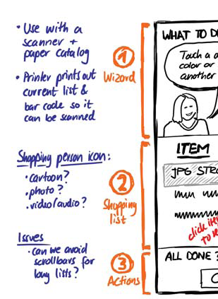
Notes
ideas about design elements left out of the drawing
alternate design options of sketch elements
design issues

Slide 16
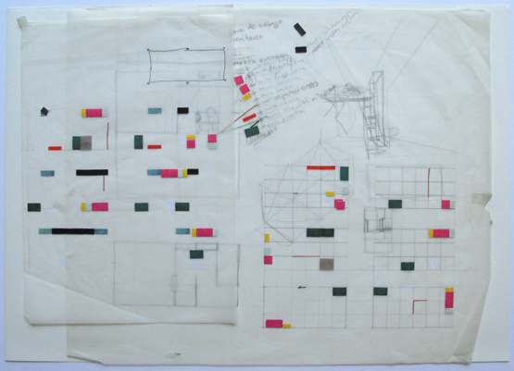
Annotations and notes
Can be drawn directly on the sketch
Or added as a layer
Tracing paper
Or digital layer
Image from http://www.shop.casaleganitos.com/silk-screens/architecture-drawings/

Slide 17
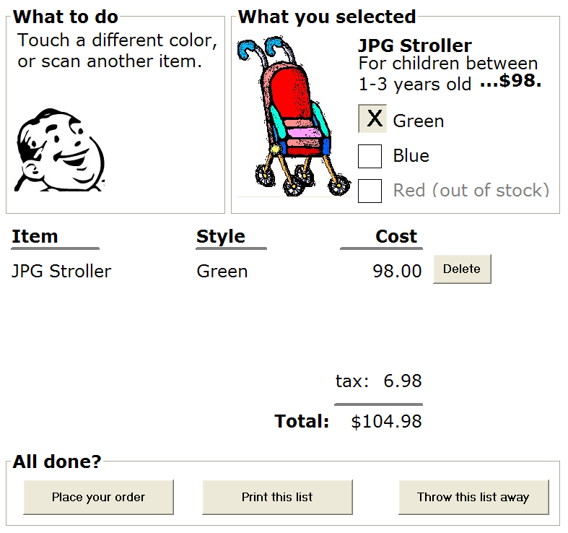
The digital sketch
Can use a drawing tool to create a digital sketch
re-usable,
editable,
closer to the ‘real thing’
Takes a bit more time, but it can be copied, edited…
Trade-offs

Slide 18
Power point- great option for digital sketching
You don’t need a fancy tool to make digital sketches
Easy to share, give to others to edit

Slide 19
But there are tools out there…
Omnigraffle is my favorite (mac only)
Adobe tools
Figma
Any others you use ….?

Slide 20
Scenario
Imagine you are running a study to capture feedback on an project in early phases
You want to be open to big changes in your interface and the design
Completely new features
Moving elements around
Which sketch do you think would work better?
B
C
A

Slide 21
Which has more openness?
Sketchy sketches leave room for the imagination and creativity
Indicate an openness to change
Does need to be legible…
To get early feedback from user : Use a sketchy sketch

Slide 22
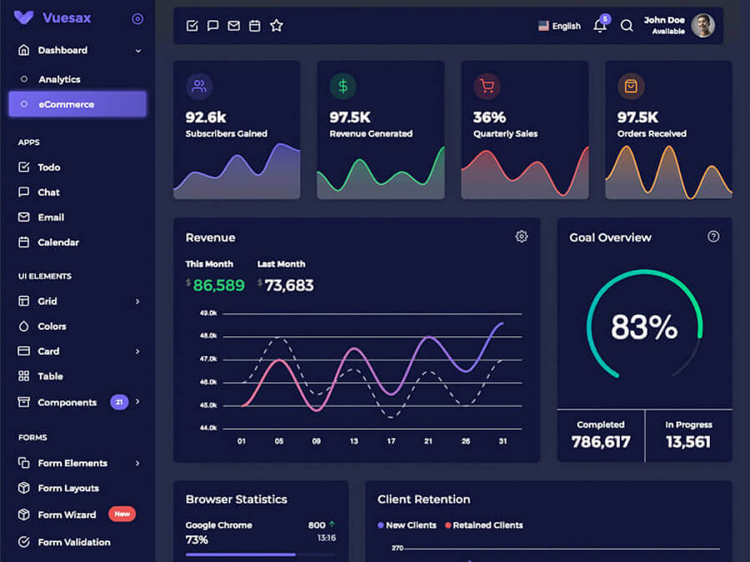
Value of openness, blanks, vague rendering
Example: (based on a real story)
Friend working with users, shows a non-sketchy sketch, in early phases of the project
What do you think everyone talks about?

Slide 23
Value of openness, blanks, vague rendering
What do you think everyone talks about?
Colors, choice of a dark theme
Side bar buttons- do I want different ones, do I understand them
Could we add a search bar?
I want to have this chart bigger
What don’t they talk about?

Slide 24
Value of openness, blanks, vague rendering
What do you think everyone talks about?
What don’t they talk about?
What are my needs
Ideas that are different than the already presented design
A non-sketchy sketch, locks you in
Especially for non-designers
Hard to have new ideas

Slide 25
But- the ability to edit, reuse, is valuable!
- Is there something in between a sketchy and a digital sketch?

Slide 26
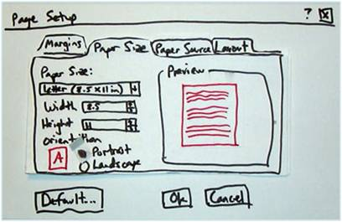
Whiteboards
Easier to erase
Nice for collaborative brainstorming - Multiple people can sketch
Photo to save the sketch

Slide 27
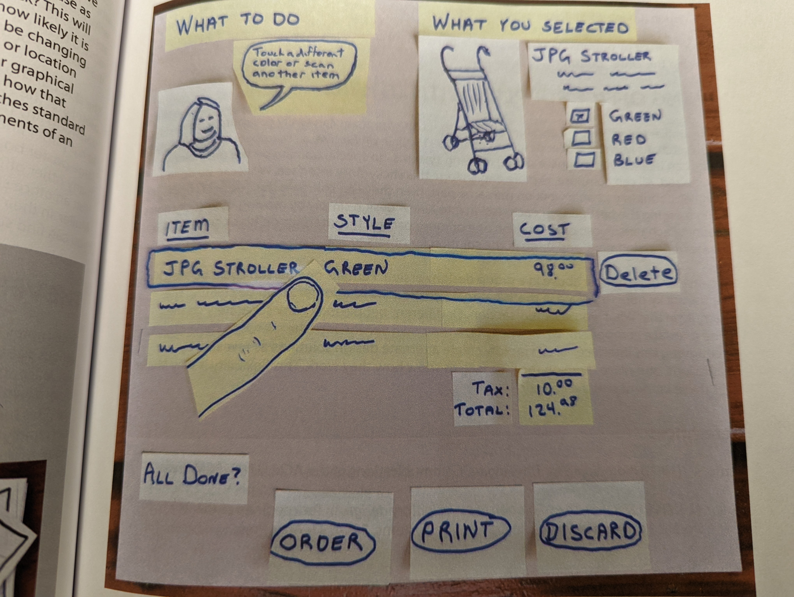
Sticky note sketch
Takes somewhat longer than a vanilla sketch
BUT- you can edit
Replace one sticky note with another
Move them around
Can do both regular sketch and sticky note
What may change?
What may I want to move?
Example from Sketching user experiences book

Slide 28
Sticky note sketch
Example from Sketching user experiences book
Interesting ideas:
Sticky note Finger with a clear acetate paper highlight
Can move the finger around, and change the selection
Add in new sticky notes to see what happens next
Photograph, to save
Could have your user ‘interact’ , you stand in for the interactive updates with sticky notes

Slide 29
Sticky notes + whiteboards + office supplies
Go for it!

Slide 30
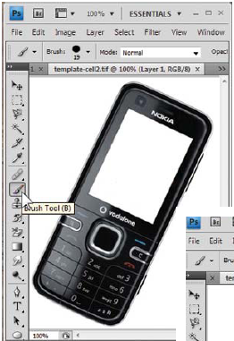
Templates
Sometimes you are ONLY changing one portion of the design
Can keep the preserved part with a reusable template

Slide 31
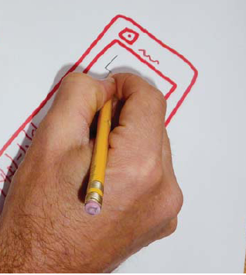
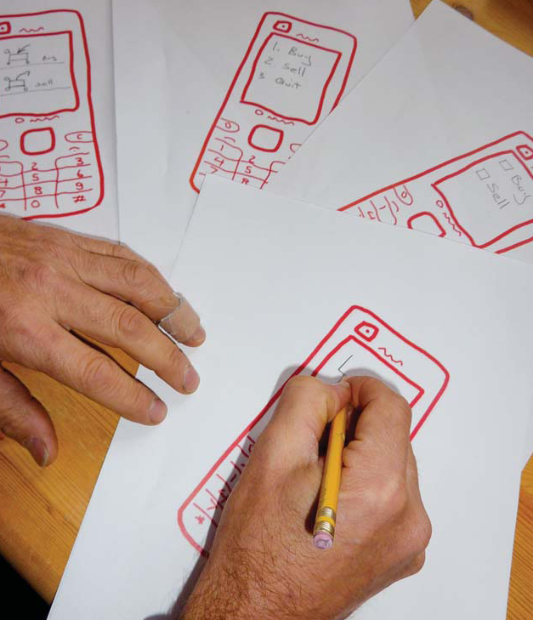
Sketching a template
Sketch, digitize, make copies

Slide 32
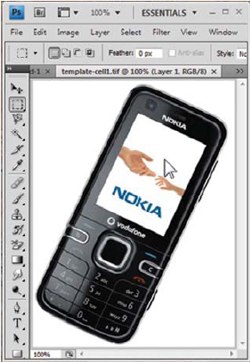
Digital template and print

Slide 33
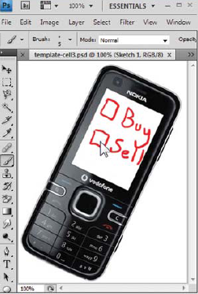
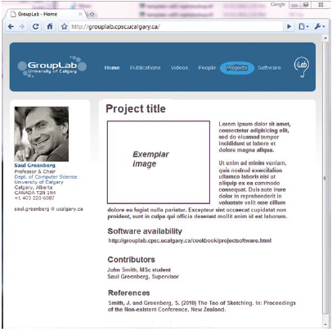
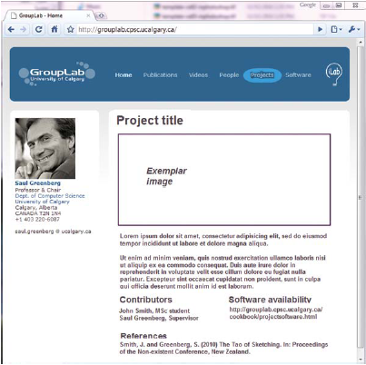
But, better if template + sketch fidelity match

Slide 34
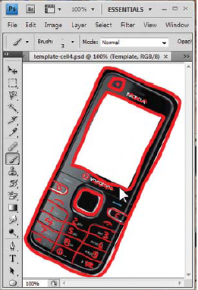
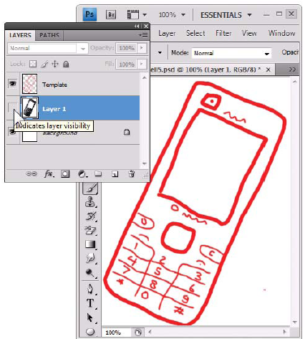
Tracing, and they printing
If it is hard to draw a phone template free-hand, you can trace
Trace digitally

Slide 35
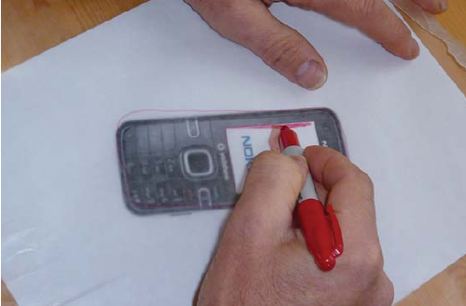
Print, trace, scan, print
Clear acetate paper

Slide 36
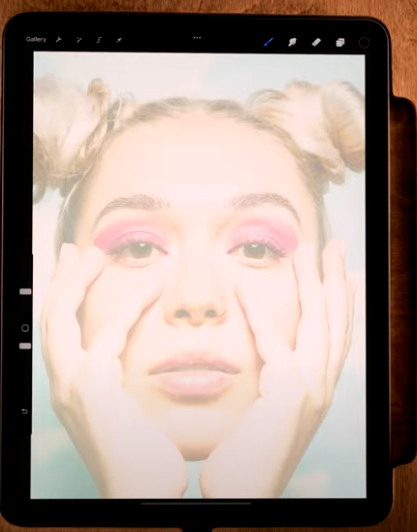
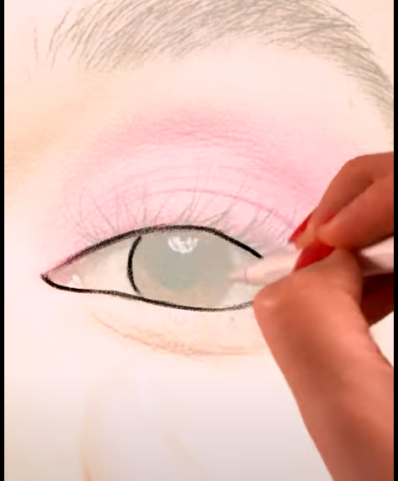
Trace on an iPad/tablet
https://www.youtube.com/watch?v=RpLRw6oq0l4

Slide 37
Let’s practice!
Canvas activity
Suppose we have opened the photo sharing app
1a:
Draw two alternate versions of an interface for selecting the photos you want to share
One moment in time- can use annotations to suggest actions and causality. Not storyboards (yet)
1b:
Suppose the users then do the authentication – like they bump the phones together, authentication success
Draw two alternate versions of an interface for accepting the photos on the other user’s phone

Slide 38
What makes a good sketch?
10-plus-10 brainstorming:
Diversity of ideas
Low-detail, so you have time to explore many concepts
Clear enough to show and explain the concept to someone else
Interface sketch
Early phases:
Sketchy, retain openness for major feedback on the core design
But clear enough that someone can understand what is shown
Annotations and notes, to convey design decisions, causality
Expect to do some sketching for yourself- not the version you use for feedback or submit
Then re-sketch to make them more clear for showing to others and on your portfolio page

